Slide 1

I.R.I.S. Mobile Scanning
I.R.I.S. Mobile Scanning Offer: Capture all kind of information in a digital way - from private to professional data – in the office or on the go.

Slide 2
What do we mean by mobile scanning?
IRISCard™ : Your Business Card Solution
  IRISCard™ 4
  New IRISCard™ Anywhere 4
  New Cardiris™ Pro 5
IRIScan™ : Your Mobile Office
  IRIScan™ 2
  IRIScan™ Pro Office 3
  New IRIScan™ Anywhere 2
IRISPen™ : Your Mobile Pen Scanner
  IRISPen™ 6
IRISnotes™ : Your Mobile Notes Taker
  IRISnotes™ 1.0
  Good news !

Slide 3
What do we mean by mobile scanning?
IRISCard™ : Your Business Card Solution
  IRISCard™ 4
  New IRISCard™ Anywhere 4
  New Cardiris™ Pro 5
IRIScan™ : Your Mobile Office
  IRIScan™ 2
  IRIScan™ Pro Office 3
  New IRIScan™ Anywhere 2
IRISPen™ : Your Mobile Pen Scanner
  IRISPen™ 6
IRISnotes™ : Your Mobile Notes Taker
  IRISnotes™ 1.0
  Good news !

Slide 4

What do we mean by mobile scanning?
Mobility = the ability to travel from one place to another →
Mobility = […] both source and destination devices, applications and people are free of the constraints imposed by physical location […] → Mark S. Taylor, Internetwork & Mobility
Mobile Scanning = the ability to scan anytime, anywhere !

Slide 5







What do we mean by mobile scanning?
Mobile Scanning
=

Slide 6
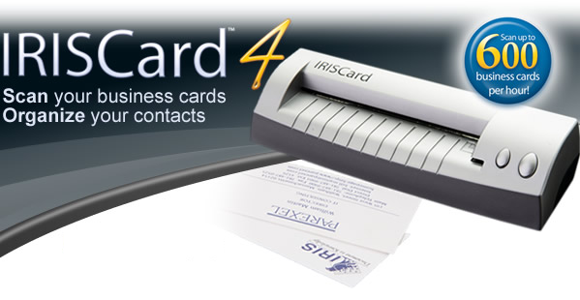





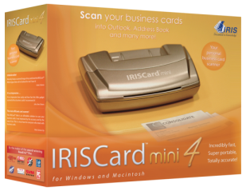
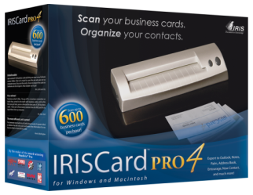
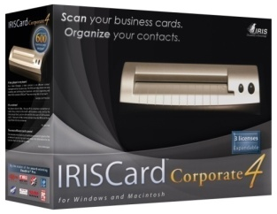
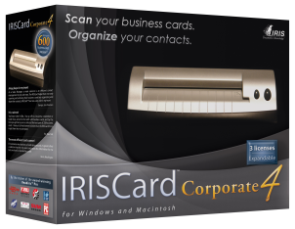
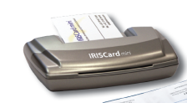
IRISCard : Your Business Card Solution

Slide 7
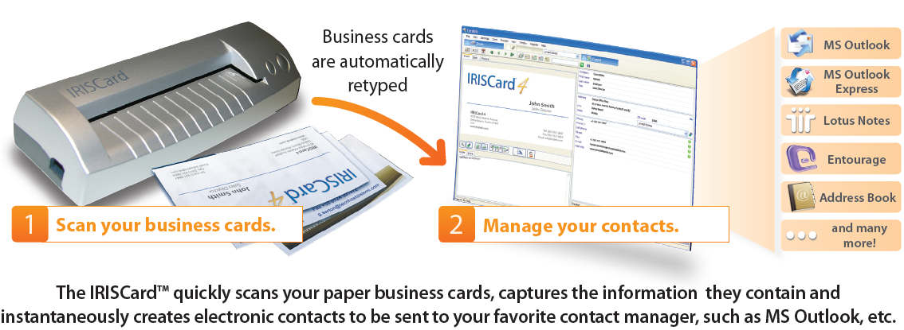
IRISCard : Your Business Card Solution
How does it work ?

Slide 8
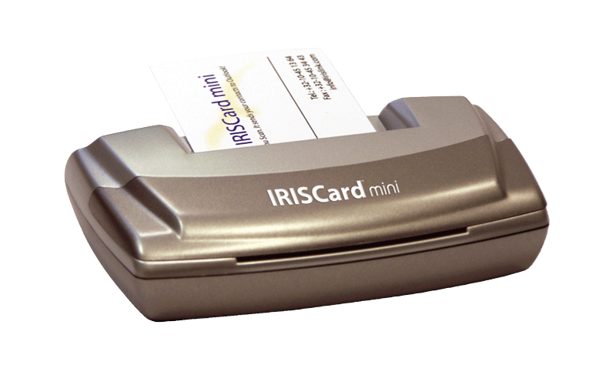
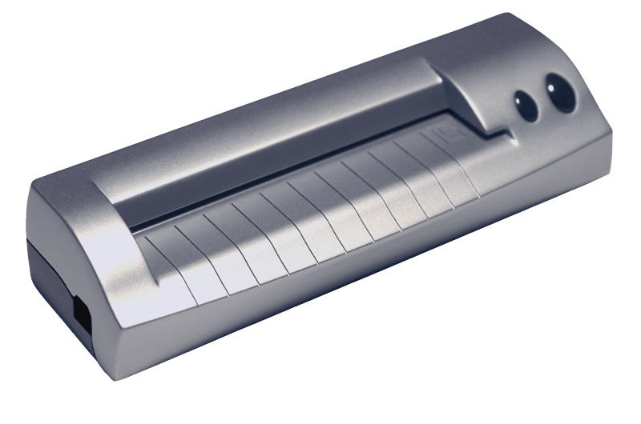
IRISCard : Your Business Card Solution
What’s in the box?
  IRISCard scanner
    Mini : grayscale
    Pro – corporate – for MS CRM : color
  Cardiris software
    Cardiris™ Pro 4

Slide 9
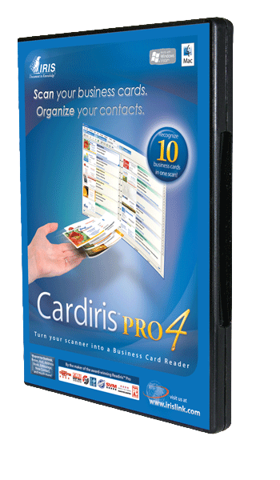
Cardiris : Recognize & manage your contacts
What can Cardiris™ do for you?
  Scan your business cards
  Convert your business cards into digital contacts
    → Cardiris™ does the retyping job for you!
  Manage your contacts
  Find duplicates
  Export to you favorite contact manager
  Export to your PDA/Smartphone

Slide 10

What do we mean by mobile scanning?
IRISCard™ : Your Business Card Solution
  IRISCard™ 4
  New IRISCard™ Anywhere 4
  New Cardiris™ Pro 5
IRIScan™ : Your Mobile Office
  IRIScan™ 2
  IRIScan™ Pro Office 3
  New IRIScan™ Anywhere 2
IRISPen™ : Your Mobile Pen Scanner
  IRISPen™ 6
IRISnotes™ : Your Mobile Notes Taker
  IRISnotes™ 1.0
  Good news !

Slide 11
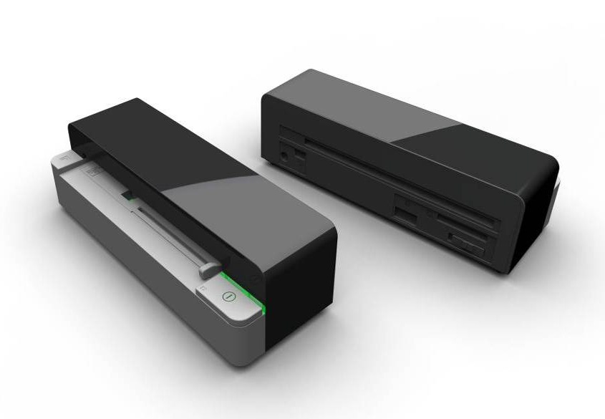
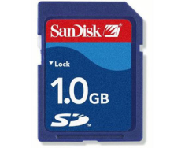
IRISCard™ Anywhere 4
Scan up to 150 business cards on battery mode!
No computer needed to scan!
Fully mobile - Battery Powered!
No Driver Installation !
Scanner compatible with PC/Mac/Linux/Unix! *
Only 4 seconds to scan a business card ! (in 300dpi & to built-in memory)
Built-In Battery
512MB Built-In Memory
→store up to 2500 business cards !
Memory Card Slot
Free 1gb SD Card included
USB Key Slot
* Software suite is only Mac & PC compatible
* Software suite is only Mac & PC compatible

Slide 12
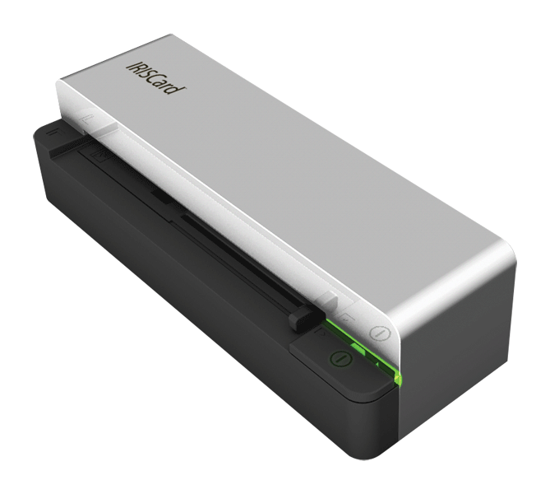
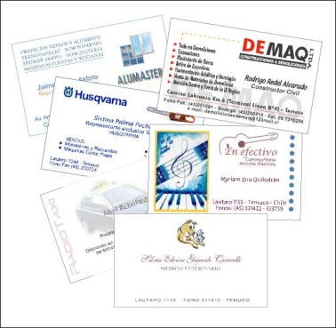
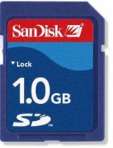
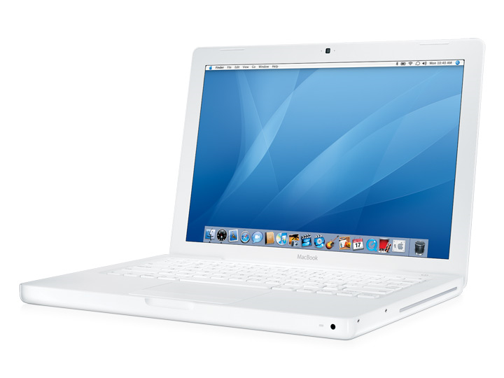
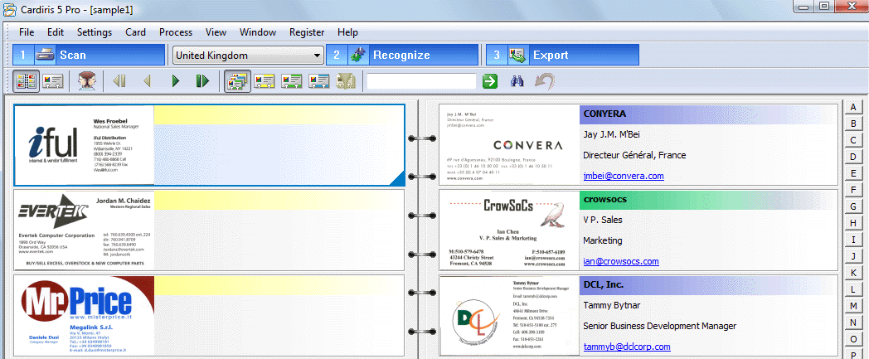

1- Scan your business cards without being connected to your computer
The scanned business cards are stored on the SD Card
2 - Put the SD Card in your computer
3 - Manage your contacts

Slide 13
What do we mean by mobile scanning?
IRISCard™ : Your Business Card Solution
  IRISCard™ 4
  New IRISCard™ Anywhere 4
  New Cardiris™ Pro 5
IRIScan™ : Your Mobile Office
  IRIScan™ 2
  IRIScan™ Pro Office 3
  New IRIScan™ Anywhere 2
IRISPen™ : Your Mobile Pen Scanner
  IRISPen™ 6
IRISnotes™ : Your Mobile Notes Taker
  IRISnotes™ 1.0
  Good news !

Slide 14

IRISCard™ Anywhere 4 // Cardiris™ Pro 5
in Cardiris™ Pro 5 :
  Improved recognition engine
  Create new cards from selected text
  Advanced image processing
  Customizable fields and categories
See demonstration of IRISCard™ Anywhere 4 and Cardiris™ Pro 5 on booth “S 3”

Slide 15
What do we mean by mobile scanning?
IRISCard™ : Your Business Card Solution
  IRISCard™ 4
  New IRISCard™ Anywhere 4
  New Cardiris™ Pro 5
IRIScan™ : Your Mobile Office
  IRIScan™ 2
  IRIScan™ Pro Office 3
  New IRIScan™ Anywhere 2
IRISPen™ : Your Mobile Pen Scanner
  IRISPen™ 6
IRISnotes™ : Your Mobile Notes Taker
  IRISnotes™ 1.0
  Good news !

Slide 16
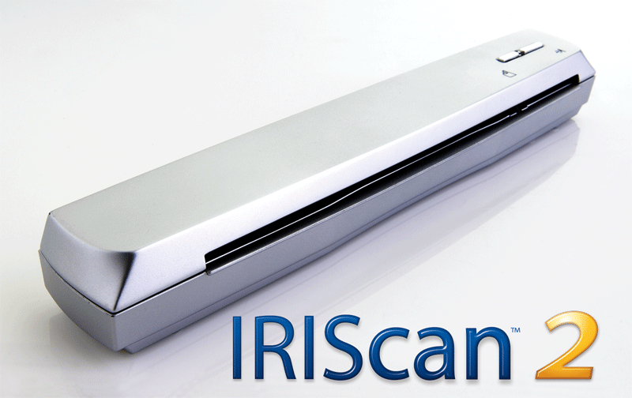

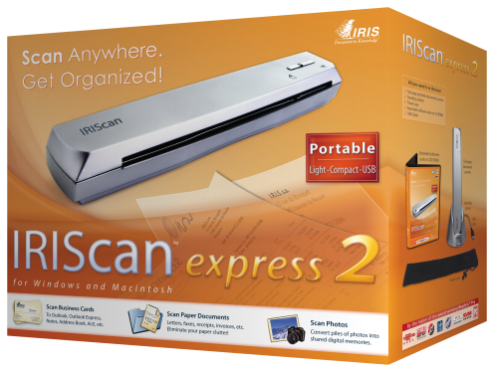
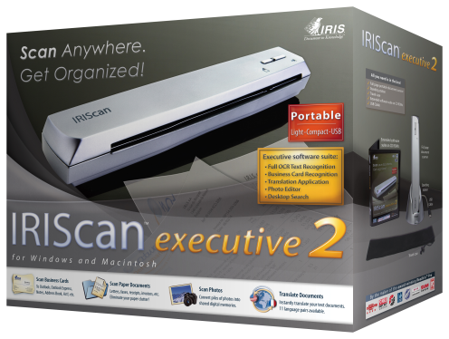
IRIScan : Your mobile Office
USB Powered

Slide 17
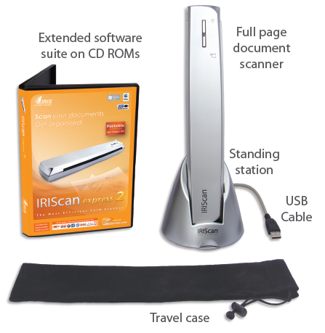
IRIScan : Your mobile Office
What’s in the box ?

Slide 18
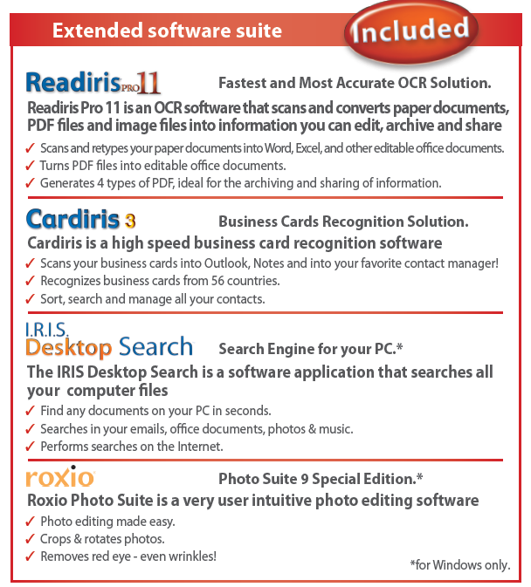
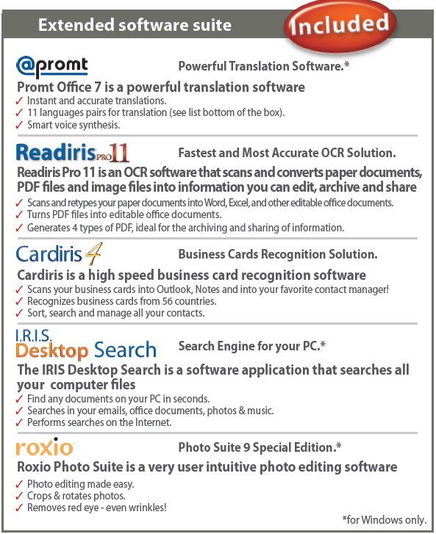
IRIScan : Your mobile Office

Slide 19
What do we mean by mobile scanning?
IRISCard™ : Your Business Card Solution
  IRISCard™ 4
  New IRISCard™ Anywhere 4
  New Cardiris™ Pro 5
IRIScan™ : Your Mobile Office
  IRIScan™ 2
  IRIScan™ Pro Office 3
  New IRIScan™ Anywhere 2
IRISPen™ : Your Mobile Pen Scanner
  IRISPen™ 6
IRISnotes™ : Your Mobile Notes Taker
  IRISnotes™ 1.0
  Good news !

Slide 20
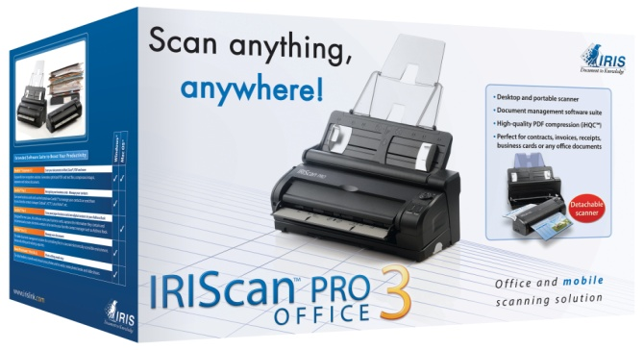
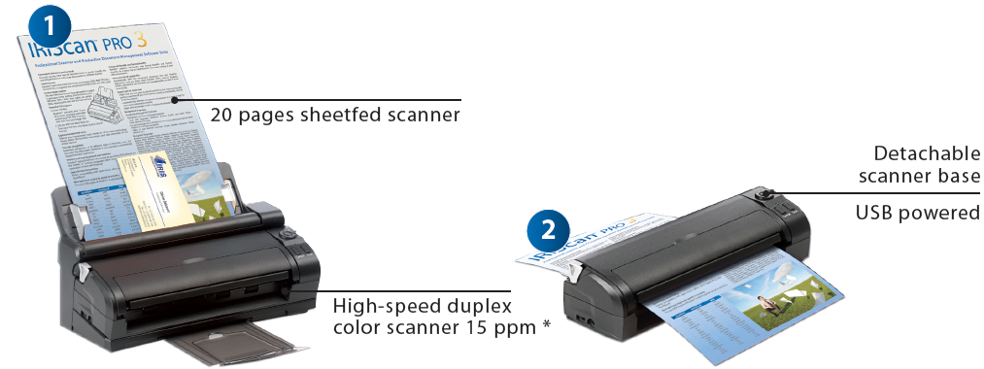
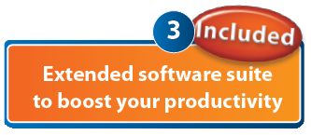
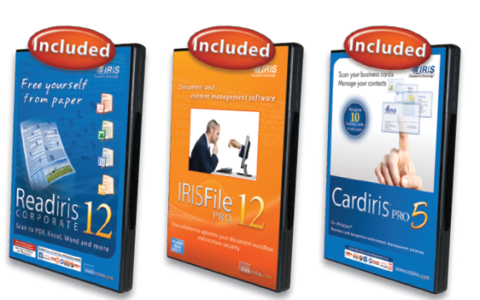
IRIScan : Your mobile Office

Slide 21
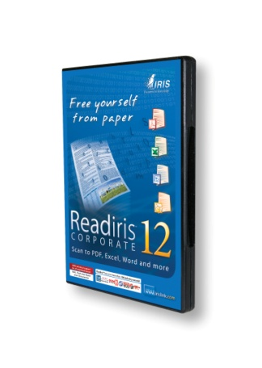
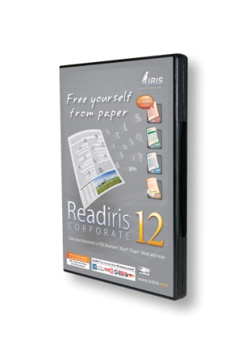
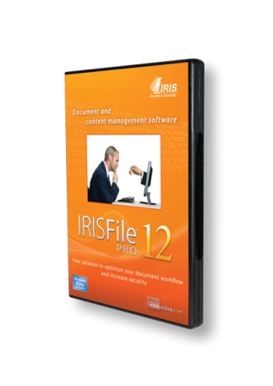
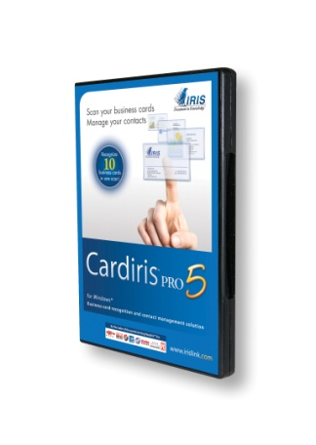
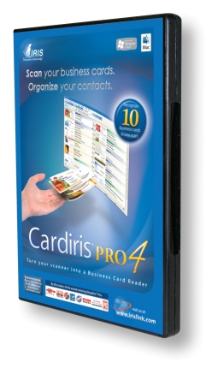

IRIScan : Your mobile Office
What’s in the box ?
A high-value software suite to cover most of the user’s needs
  Convert any paper document, PDF or image into digital files you can edit, index and share
  Manage your documents and content by optimizing the document workflow and increase security (PC only)
  Scan, recognize and manage your business cards
  Edit pictures (PC only)

Slide 22
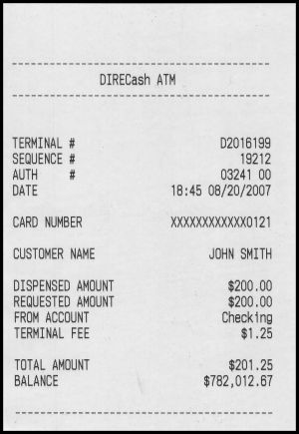


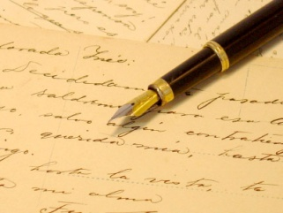
IRIScan : Your mobile Office
What’s in the box ?
A mobile & desktop scanner to use the software suite
  Scan in or away from your office
  Scan any type of documents

Slide 23
What do we mean by mobile scanning?
IRISCard™ : Your Business Card Solution
  IRISCard™ 4
  New IRISCard™ Anywhere 4
  New Cardiris™ Pro 5
IRIScan™ : Your Mobile Office
  IRIScan™ 2
  IRIScan™ Pro Office 3
  New IRIScan™ Anywhere 2
IRISPen™ : Your Mobile Pen Scanner
  IRISPen™ 6
IRISnotes™ : Your Mobile Notes Taker
  IRISnotes™ 1.0
  Good news !

Slide 24
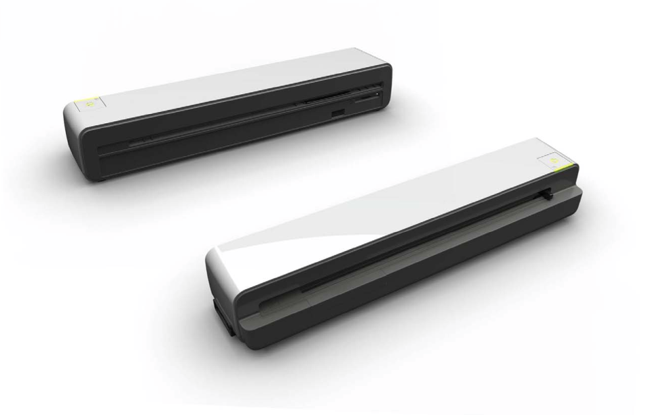
IRIScan™ Anywhere 2
Built-In Battery
Memory Card Slot
Free 1gb SD Card included
USB Key Slot
Built-In Memory
512MB
No computer needed to scan!
Fully mobile - Battery Powered!
No Driver Installation !
Scanner compatible with PC/Mac/Linux/Unix!*
10 seconds to scan a page ! (in 300dpi & to built-in memory)
Scan up to 100 A4 pages on battery mode!
* Software suite is only Mac & PC compatible

Slide 25

IRIScan™ Anywhere 2
See demonstration of IRIScan™ Anywhere 2 on booth “S 2”

Slide 26




Extended software suite
  Convert any paper document, PDF or image into digital files you can edit, index and share → The scanned documents can be converted & filed electronically allowing for a more paper free existence
  Scan, recognize and manage your business cards → Get rid of your cumbersome paper business cards and keep your contacts up-to-date (Cardiris™ Pro 4 for Mac)
  Edit pictures → Transfer & touch up you photos, create photo book and photo slideshows (PC only)

Slide 27
What do we mean by mobile scanning?
IRISCard™ : Your Business Card Solution
  IRISCard™ 4
  New IRISCard™ Anywhere 4
  New Cardiris™ Pro 5
IRIScan™ : Your Mobile Office
  IRIScan™ 2
  IRIScan™ Pro Office 3
  New IRIScan™ Anywhere 2
IRISPen™ : Your Mobile Pen Scanner
  IRISPen™ 6
IRISnotes™ : Your Mobile Notes Taker
  IRISnotes™ 1.0
  Good news !

Slide 28
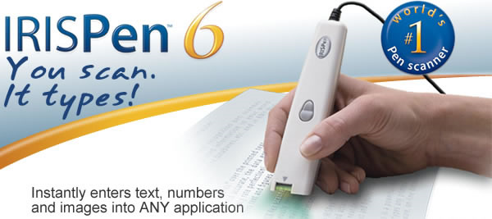


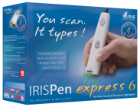
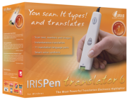
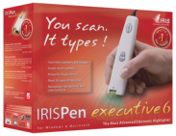
IRISPen : Your Mobile Pen Scanner

Slide 29
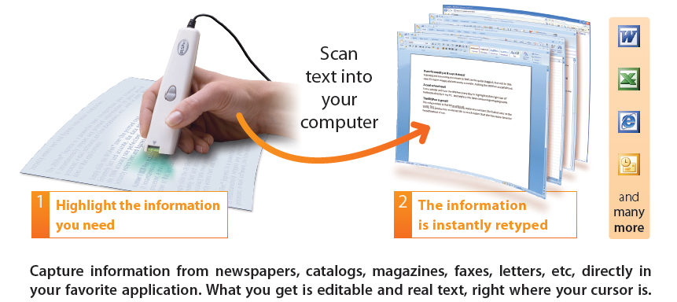
IRISPen : Your Mobile Pen Scanner

Slide 30
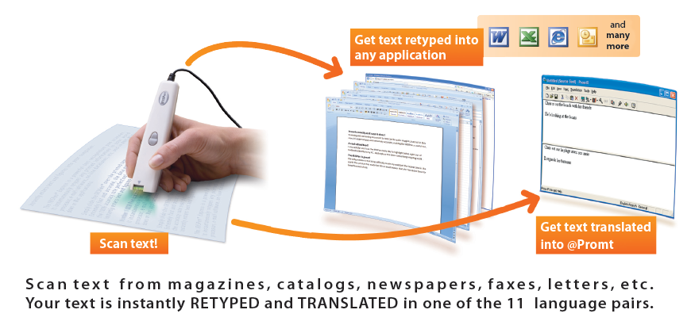
IRISPen : Your Mobile Pen Scanner

Slide 31
What do we mean by mobile scanning?
IRISCard™ : Your Business Card Solution
  IRISCard™ 4
  New IRISCard™ Anywhere 4
  New Cardiris™ Pro 5
IRIScan™ : Your Mobile Office
  IRIScan™ 2
  IRIScan™ Pro Office 3
  New IRIScan™ Anywhere 2
IRISPen™ : Your Mobile Pen Scanner
  IRISPen™ 6
IRISnotes™ : Your Mobile Notes Taker
  IRISnotes™ 1.0
  Good news !

Slide 32


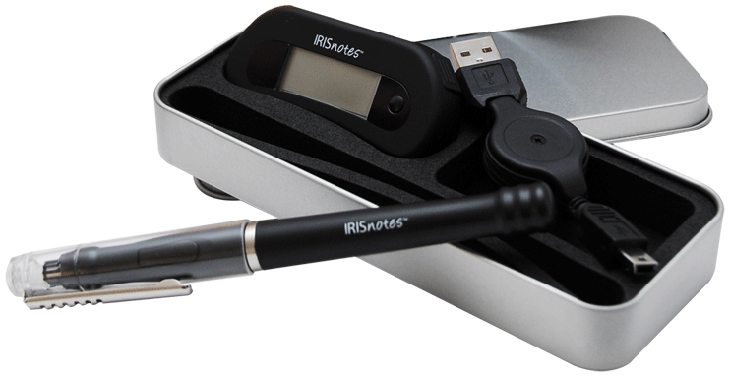

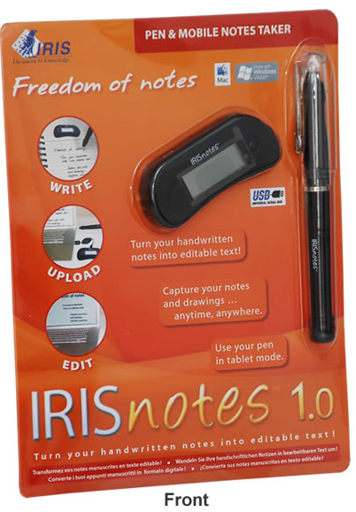
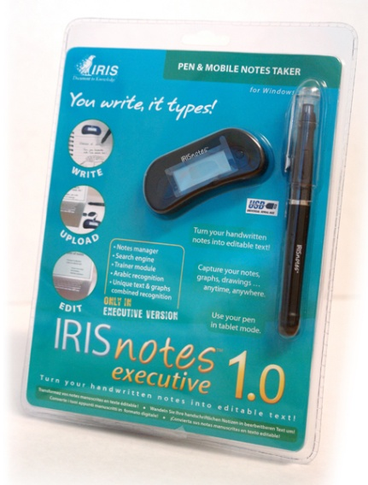
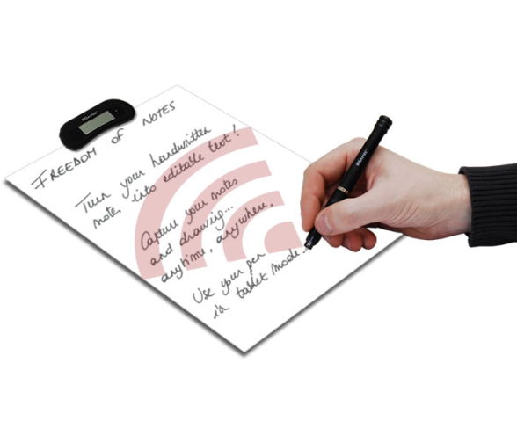
IRISnotes : Your Mobile Notes Taker

Slide 33
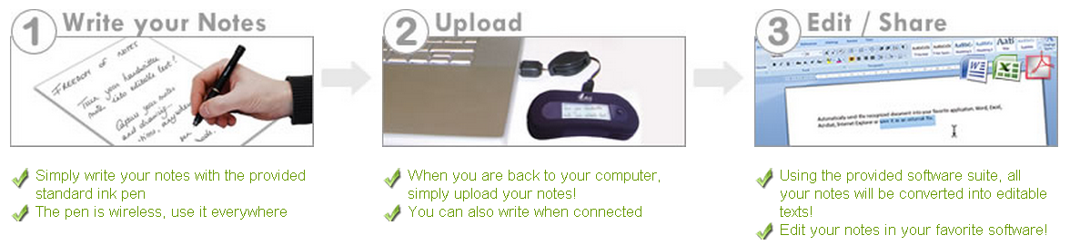
IRISnotes : Your Mobile Notes Taker
What is the IRISnotes ?
IRISnotes is a pen and mobile note taker
  Capture handwritten notes, drawings, graphs …
  Export to you computer
  Instantly convert your notes into editable text in a wide range of languages
  Edit, save and share them.
How does it work ?

Slide 34

IRISnotes : Your Mobile Notes Taker
What is common to both versions ?
IRiSnotes 1.0 // IRISnotes executive 1.0
Portable Pen
USB receiver → NO COMPUTER REQUIRED WHEN CAPTURING NOTES
Easy Note taker (Notes capture software -> not for recognition)
Intelligent handwritten notes recognition (see later)
Up to 100 A4 pages storage capacity
Regular ink refills and batteries
Compatible with any kind of paper
Use it as a mouse in online mode
Supports the Vista® /7 Tablet Mode

Slide 35

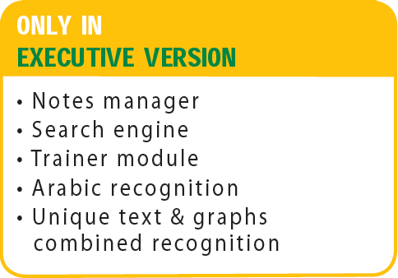
IRISnotes : Your Mobile Notes Taker
What’s the difference between both versions?
IRISnotes 1.0 | IRISnotes executive 1.0
MyScript Notes 2.2 Lite | IRISnotes executive 1.0 software
= Basic recognition software | = Advanced recognition software
22 Recognized languages | 26 Recognized languages
English - Canada, English - GB, English - US, German, Simplified Chinese, Traditional Chinese, Korean, Danish, Spanish, Spanish - Mexico, Finnish, French, French - Canada, Greek, Italian, Japanese, Dutch, Norwegian, Portuguese, Portuguese - Brazil, Russian, Swedish | Arabic, Chinese (Simp. & Trad.), Danish, Dutch, English (Can/ UK/ US), Finnish, French (Can/ Fr), German, Greek, Hungarian, Italian, Japanese, Korean, Norwegian, Polish, Portuguese (Br/ Port.), Russian, Spanish (Mex./ Sp.), Swedish, Turkish

Slide 36
What do we mean by mobile scanning?
IRISCard™ : Your Business Card Solution
  IRISCard™ 4
  New IRISCard™ Anywhere 4
  New Cardiris™ Pro 5
IRIScan™ : Your Mobile Office
  IRIScan™ 2
  IRIScan™ Pro Office 3
  New IRIScan™ Anywhere 2
IRISPen™ : Your Mobile Pen Scanner
  IRISPen™ 6
IRISnotes™ : Your Mobile Notes Taker
  IRISnotes™ 1.0
  Good news !

Slide 37

IRISnotes : Your Mobile Notes Taker
IRISnotes executive 1.0 is now available for Mac !
See demonstration of IRISnotes executive 1.0 for Mac on booth “S 14”

Slide 38
I.R.I.S. Products & Technologies offers you a wide range of useful solutions
→ Visit the dedicated booth & ask for a live demonstration
… Stay tuned … there’s more to come !

Slide 39

Thank you for your attention
Any questions ?

